Slide 1
FromThePage
Ben Brumfield February 23, 2023

Slide 2
Background

Slide 3
Software Origins
Amateur digital edition (2005-2008)
Released under open source license (2009)
Crowdsourced transcription by libraries, archives, and museums (2010+)
Digital scholarly editions (2014+)

Slide 4
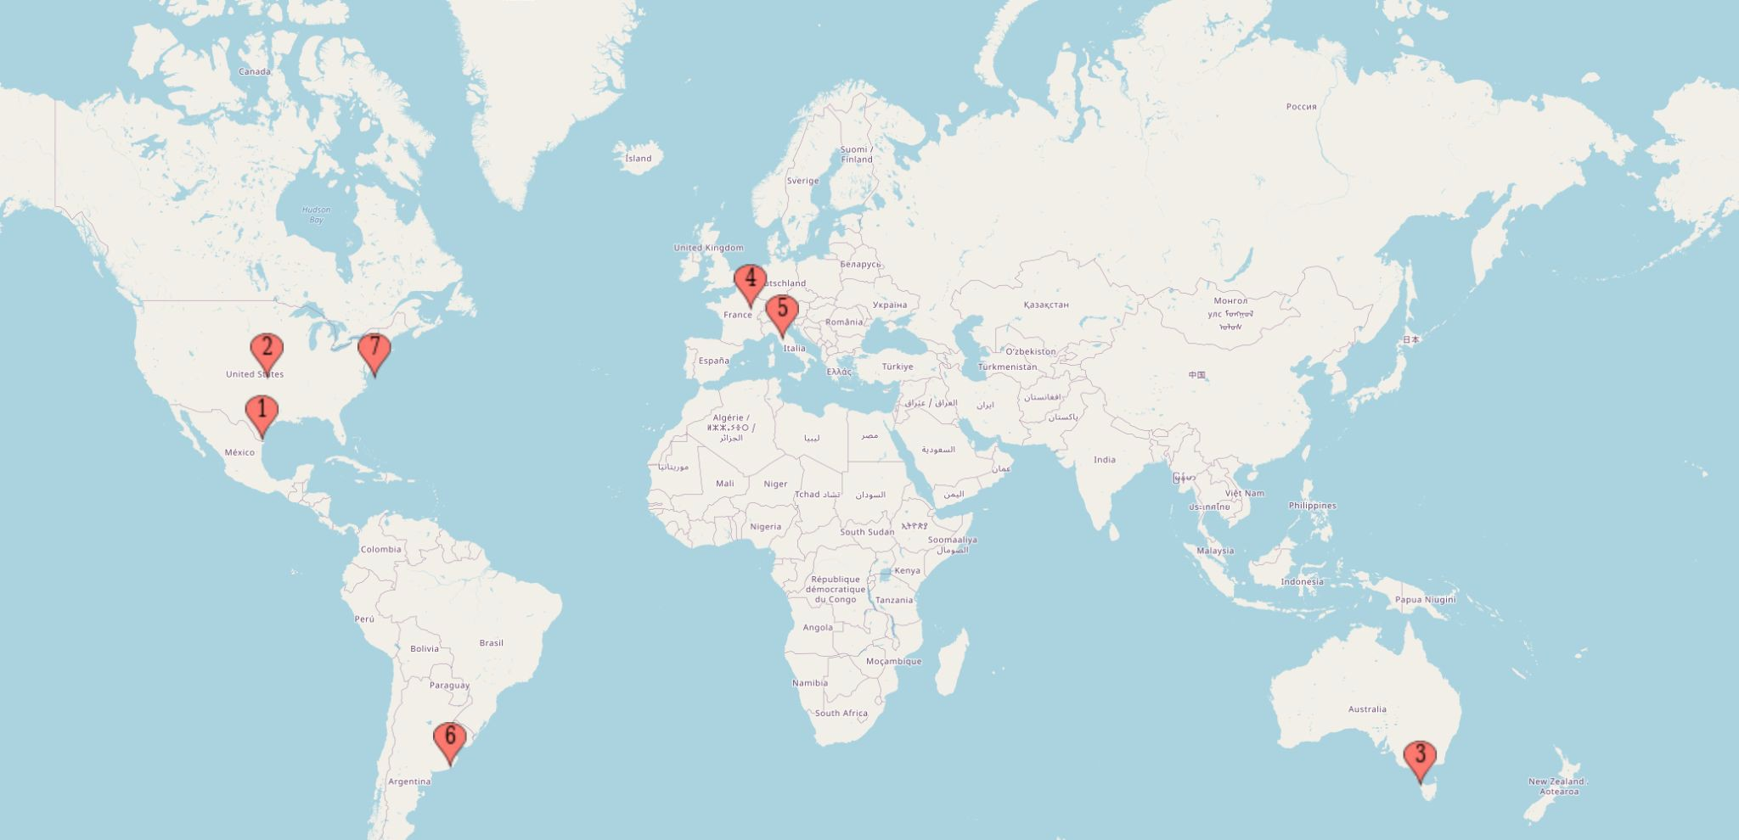
Open source FromThePage installations

Slide 5
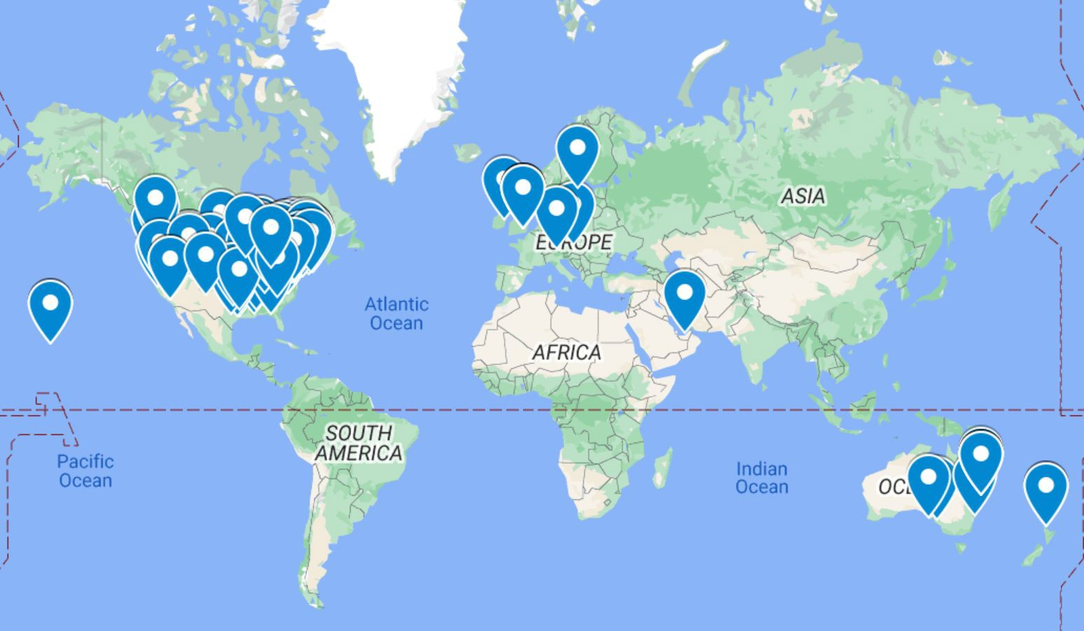
Organizations hosted on FromThePage.com

Slide 6















Slide 7
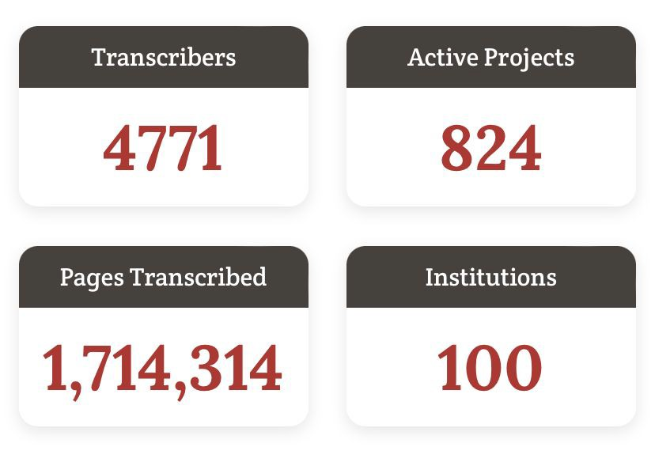

Slide 8
Collaborative manuscript transcription and OCR/HTR text correction

Slide 9
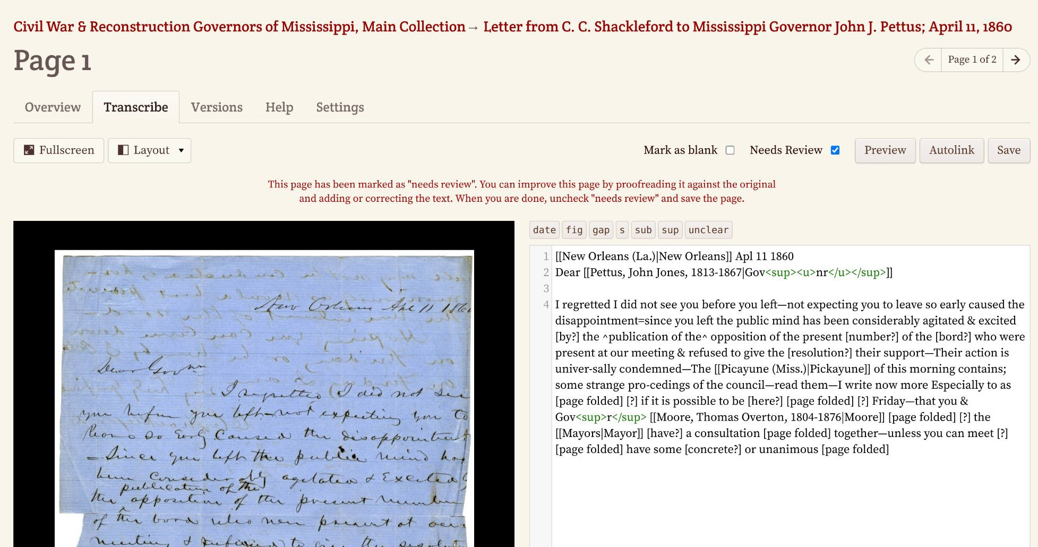

Slide 10
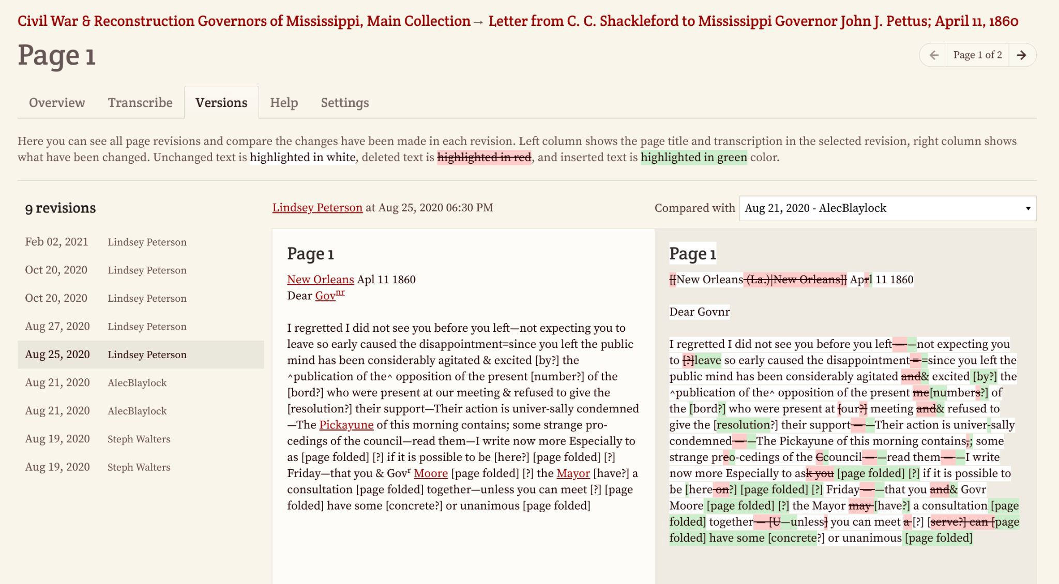

Slide 11
Textual Mark-up

Slide 12
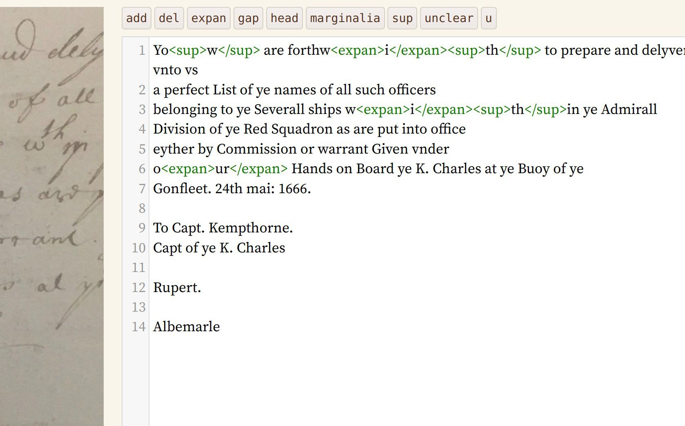
Editor buttons and mark-up

Slide 13
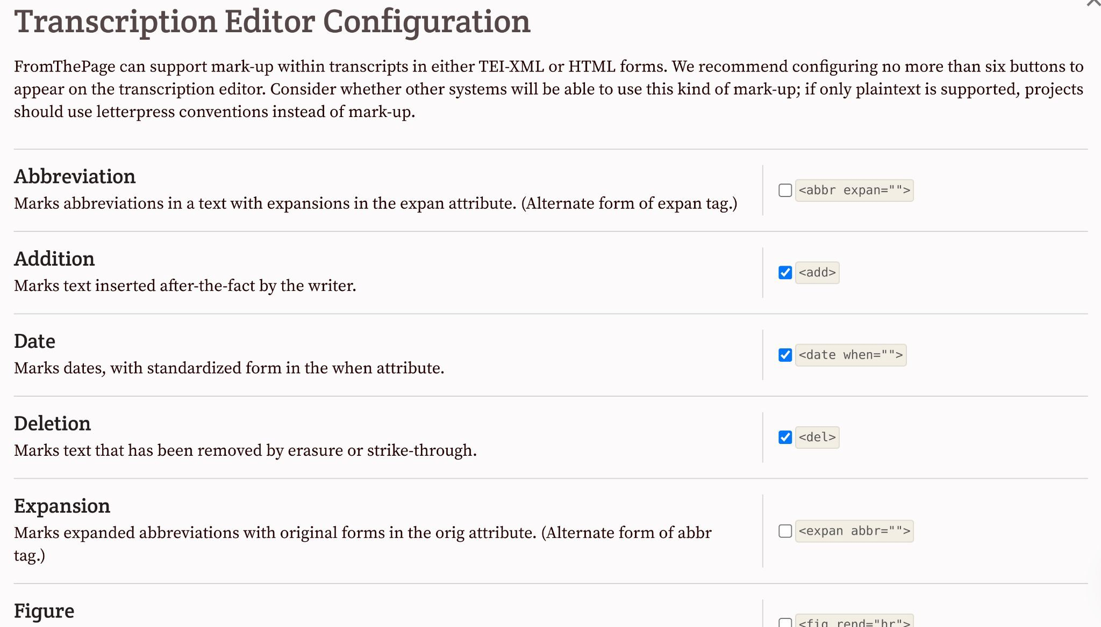

Slide 14
Supported mark-up tags
abbr abbreviation add addition catchword
cb column begin
date
del deletion expan expansion figure
footnote gap
hi highlight
ins insertion
lb line break marginalia milestone
reg regularization
stamp
strike strike-through
sub subscript sup superscript supplied unclear
Others are also possible…

Slide 15
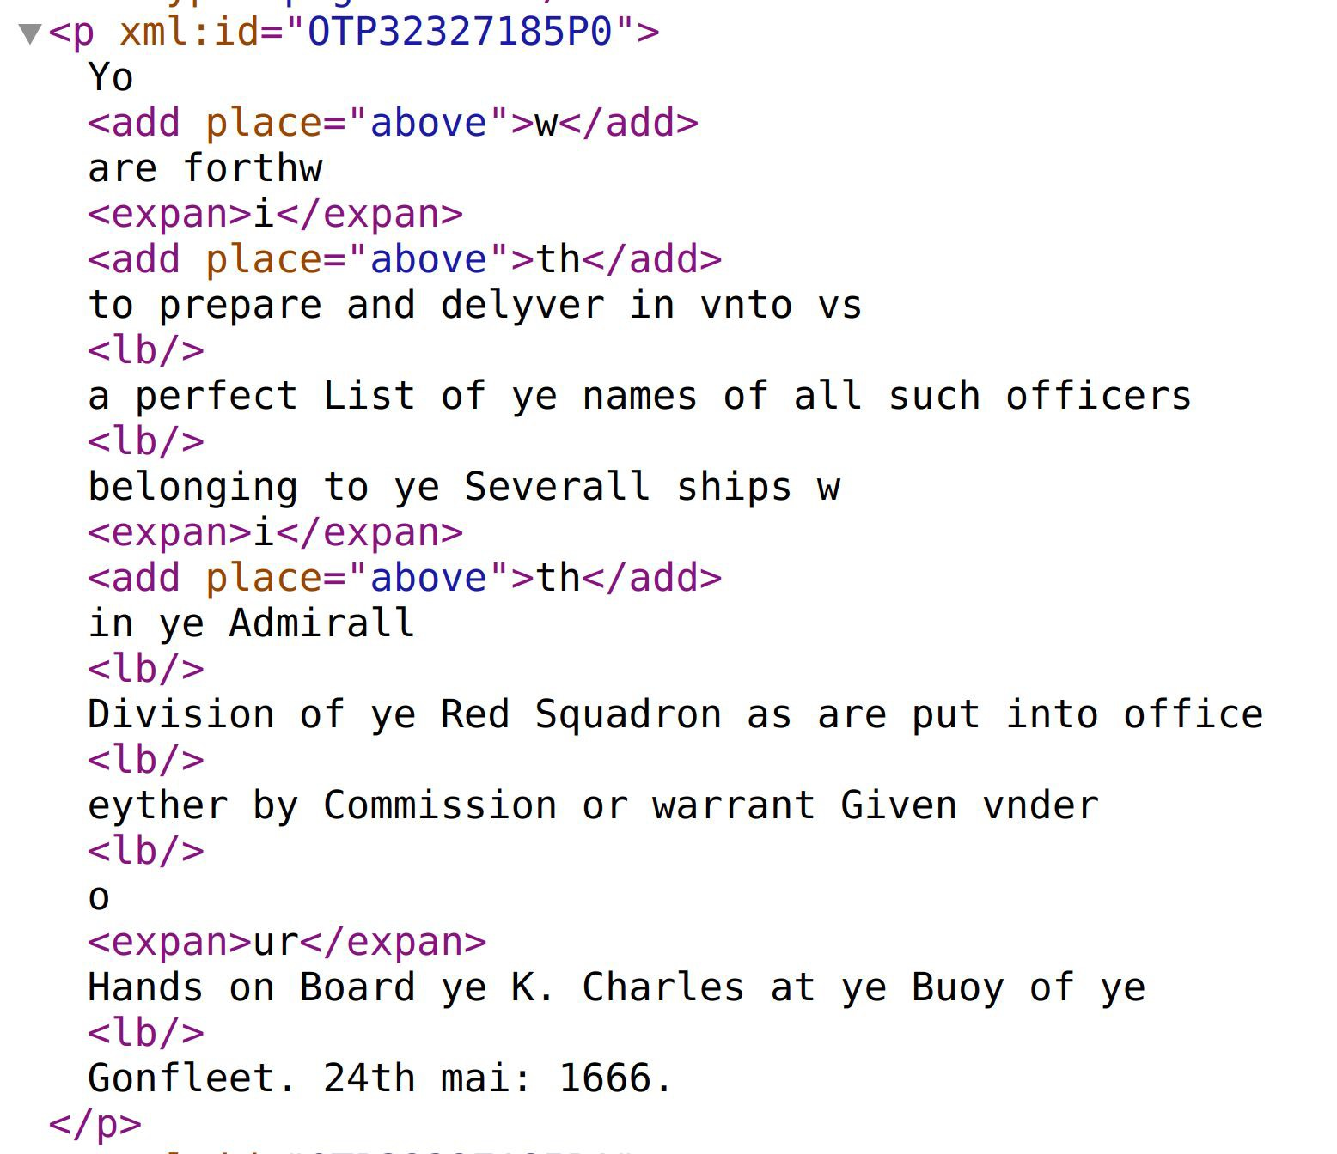
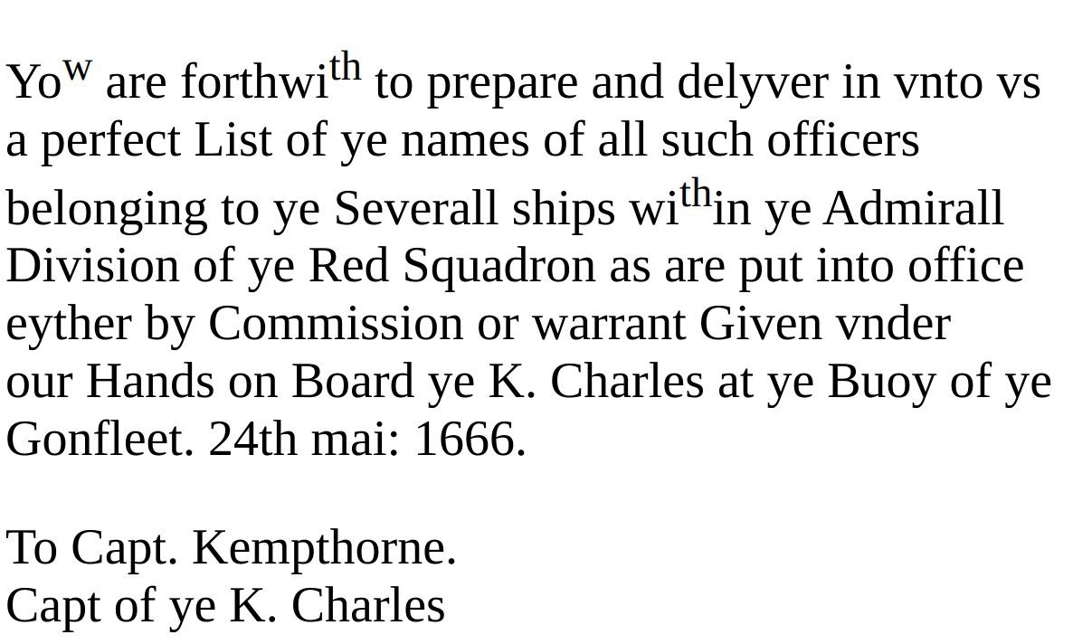
TEI-XML and HTML exports of mark-up

Slide 16
Indexing and Annotation

Slide 17


Slide 18
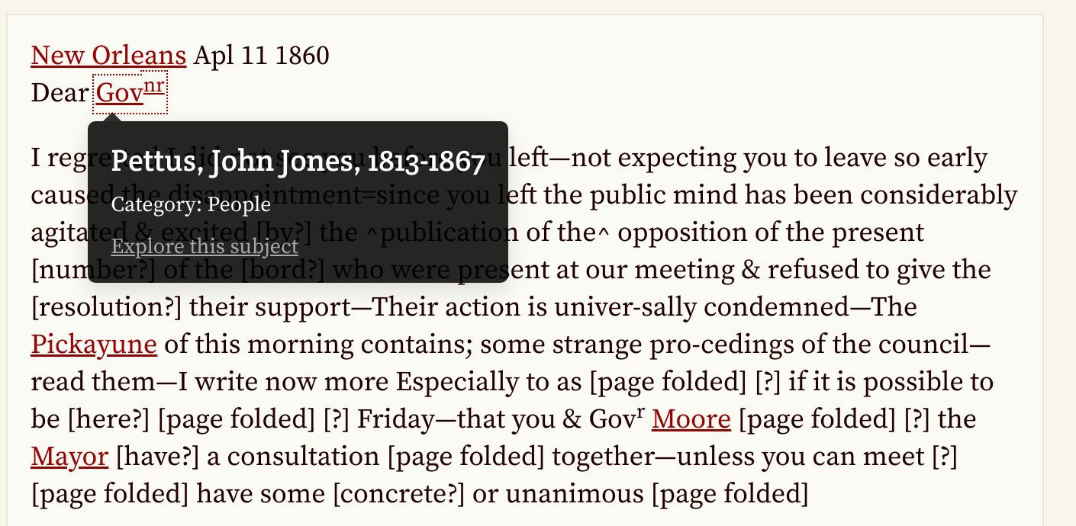

Slide 19
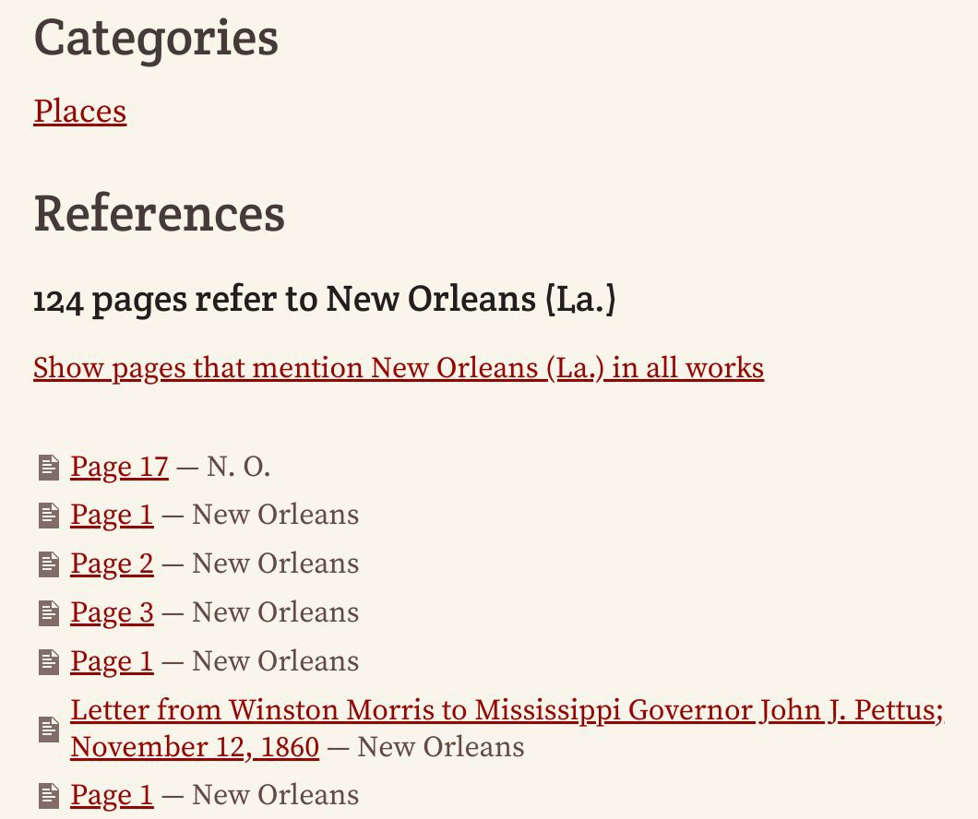

Slide 20
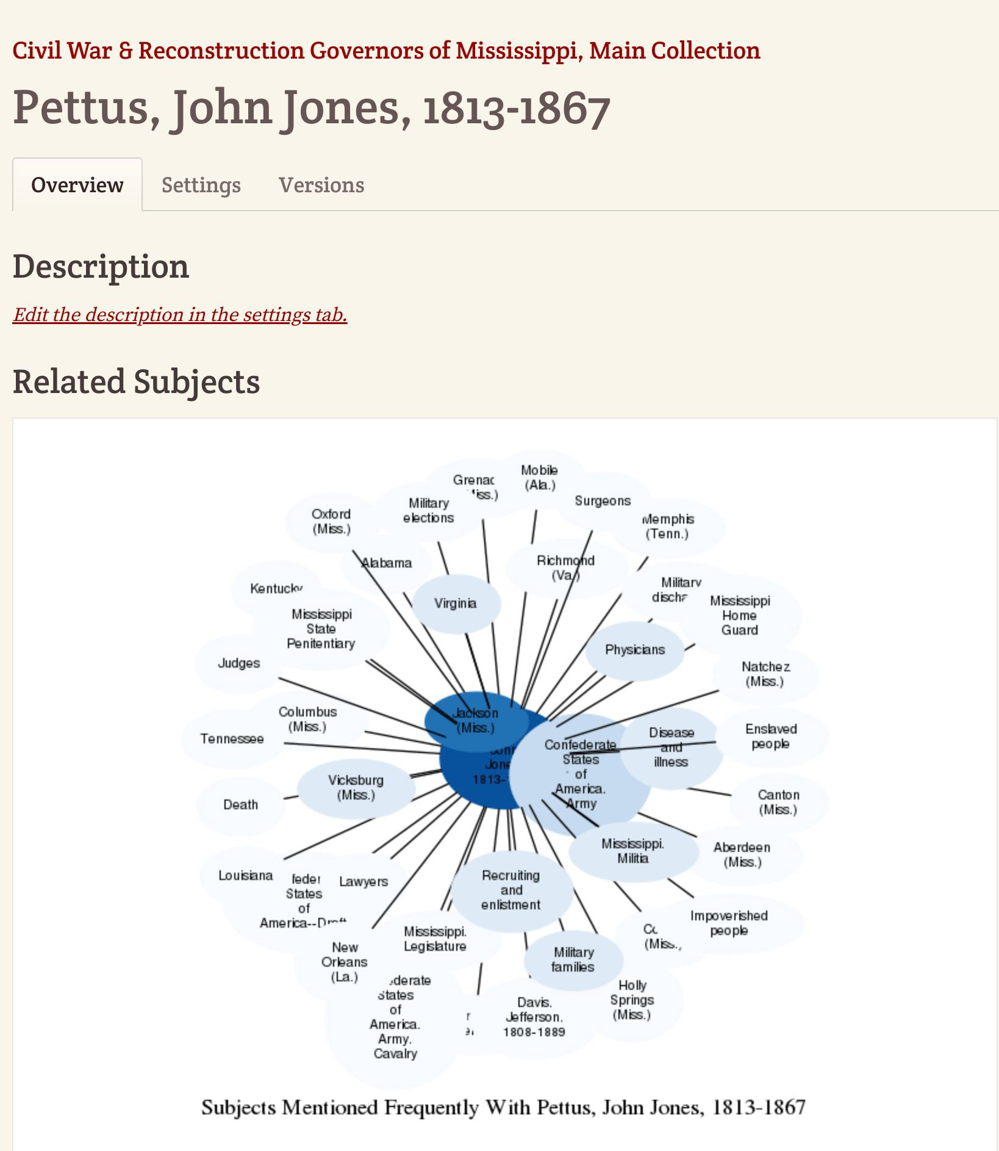
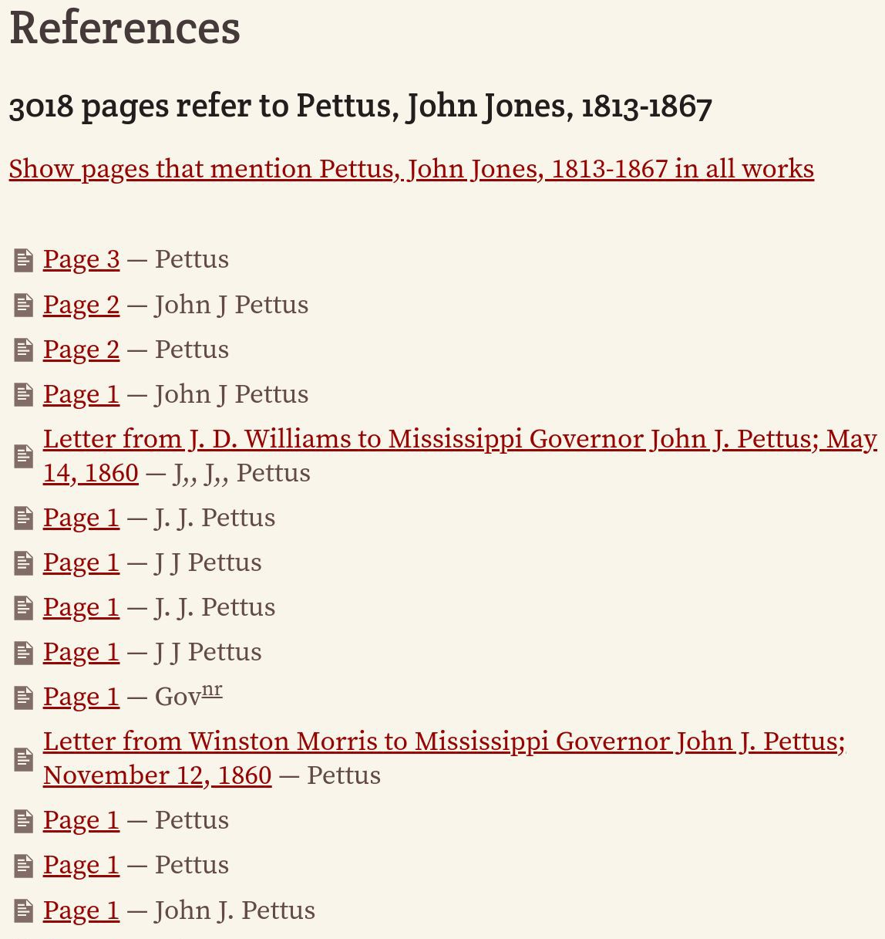

Slide 21
Case Studies:
Scholarly Editions using FromThePage

Slide 22
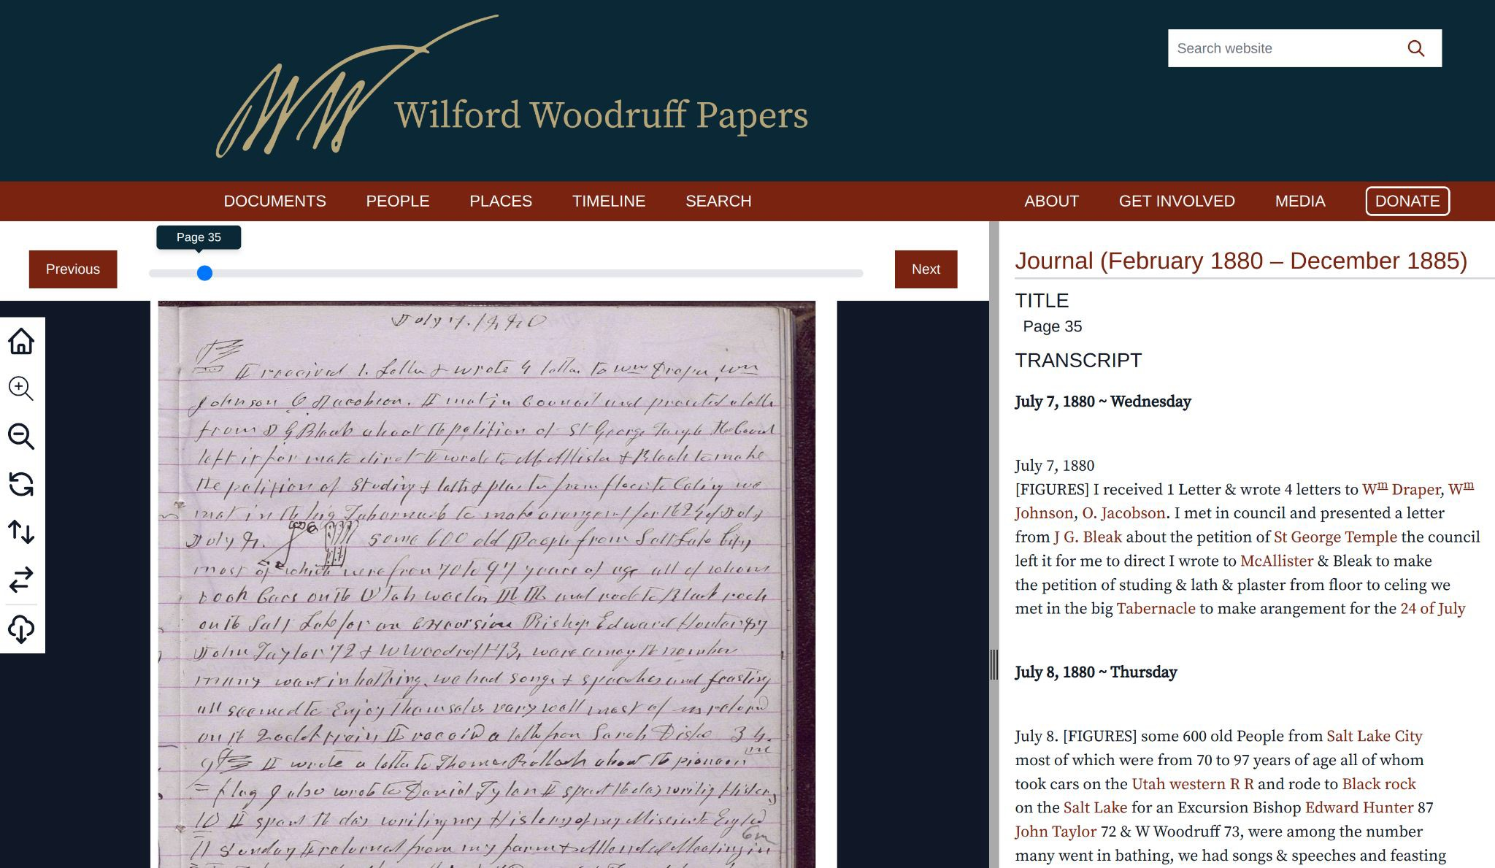

Slide 23
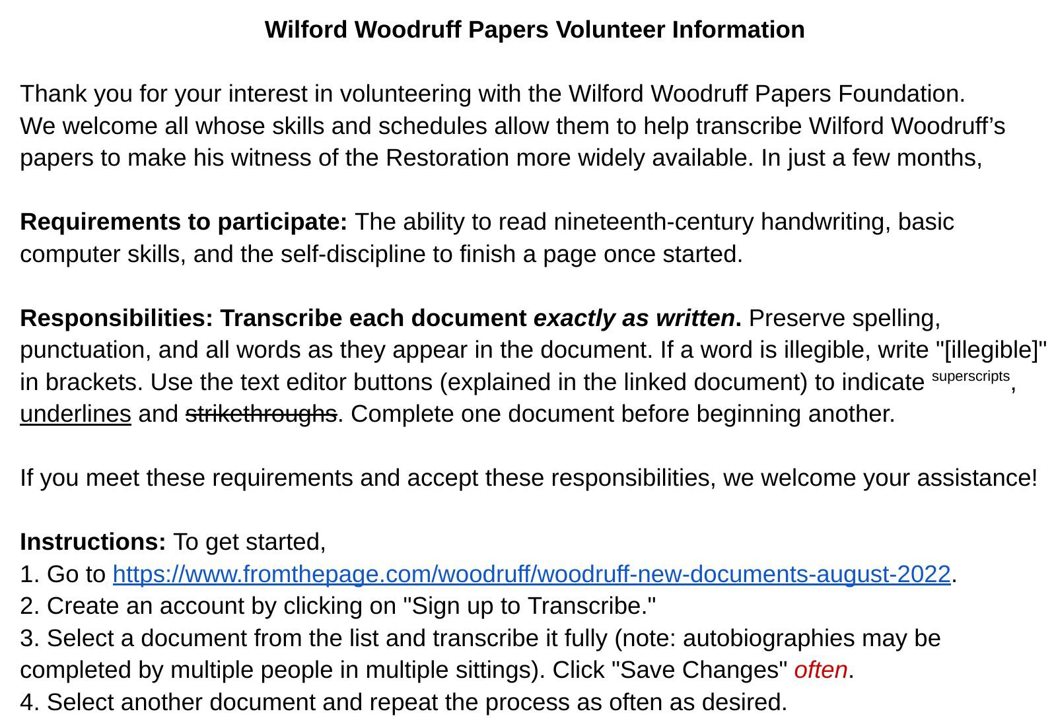

Slide 24
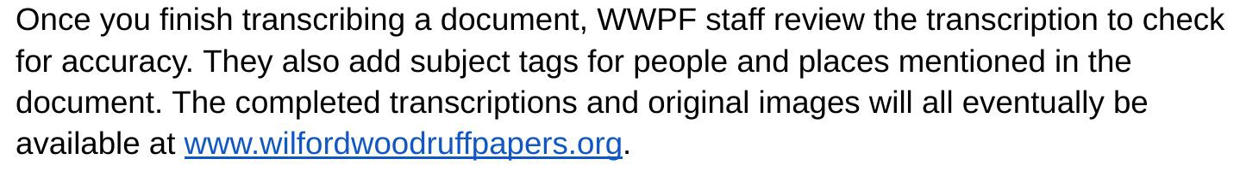
Wilford Woodruff Paper Workflow
Volunteer transcription
Review by staff Annotation by staff
Publication of annotated documents (via API)

Slide 25
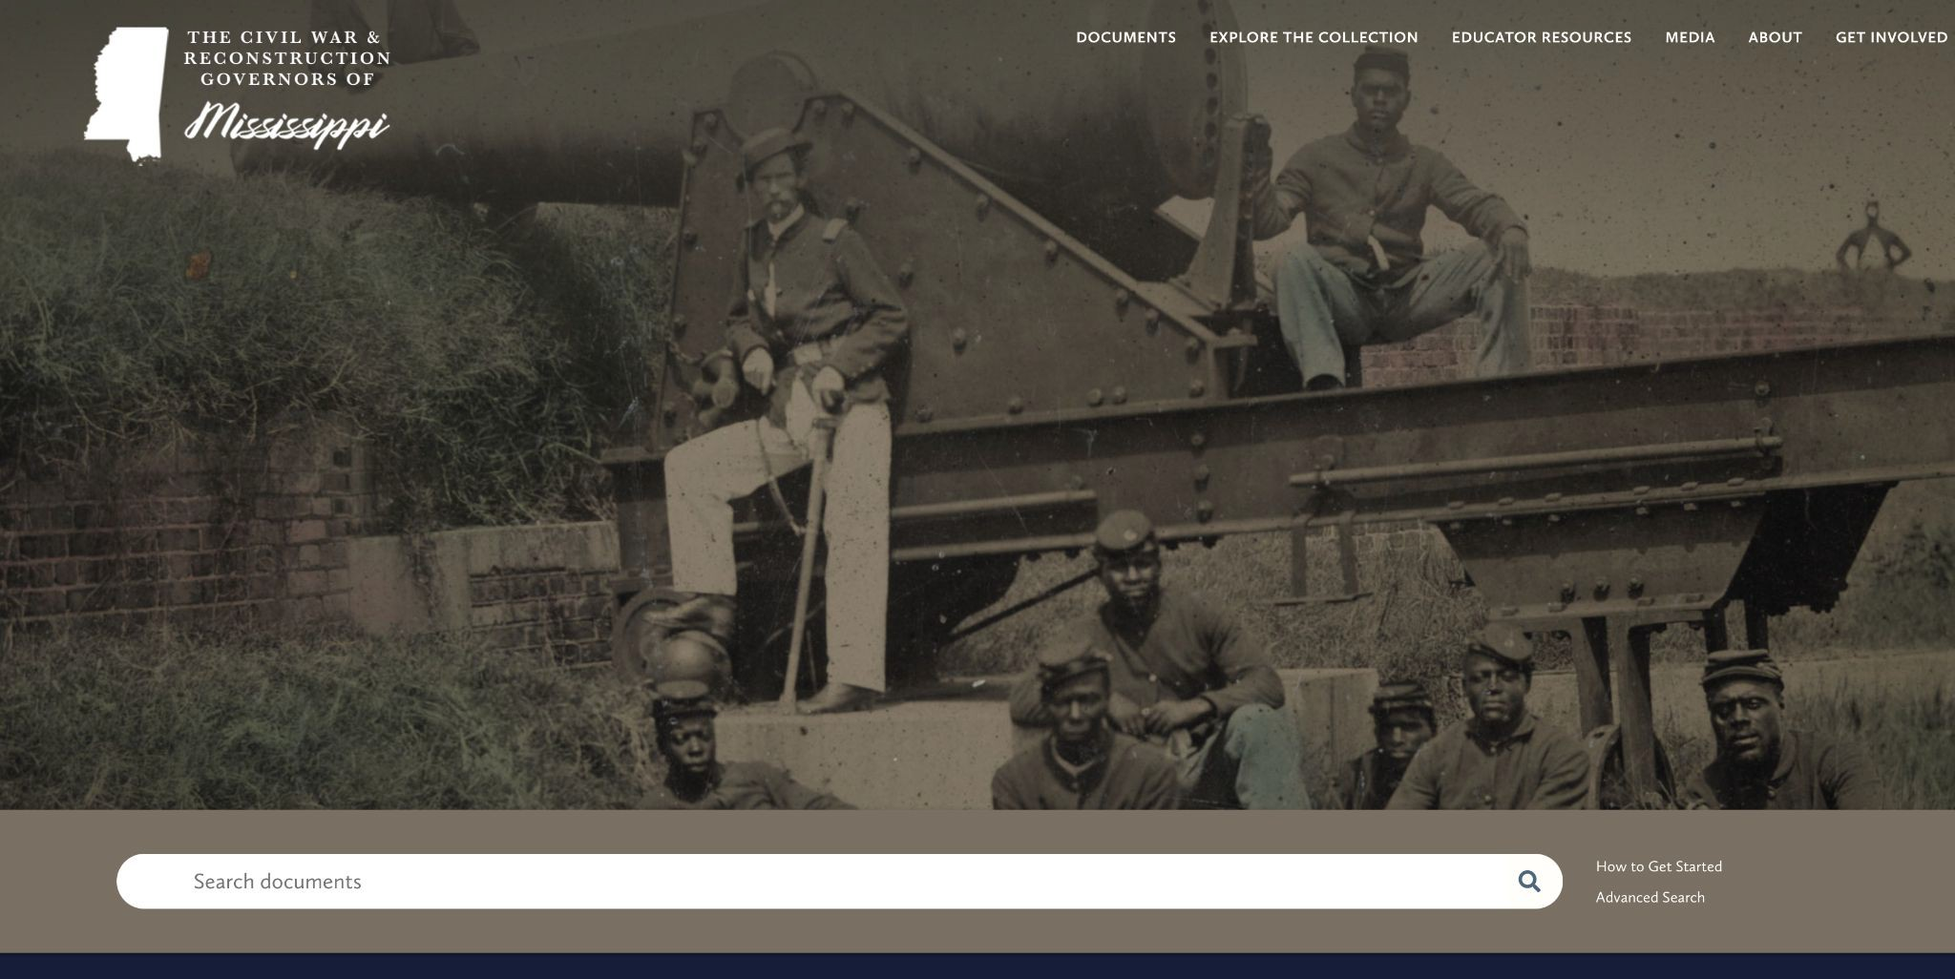

Slide 26
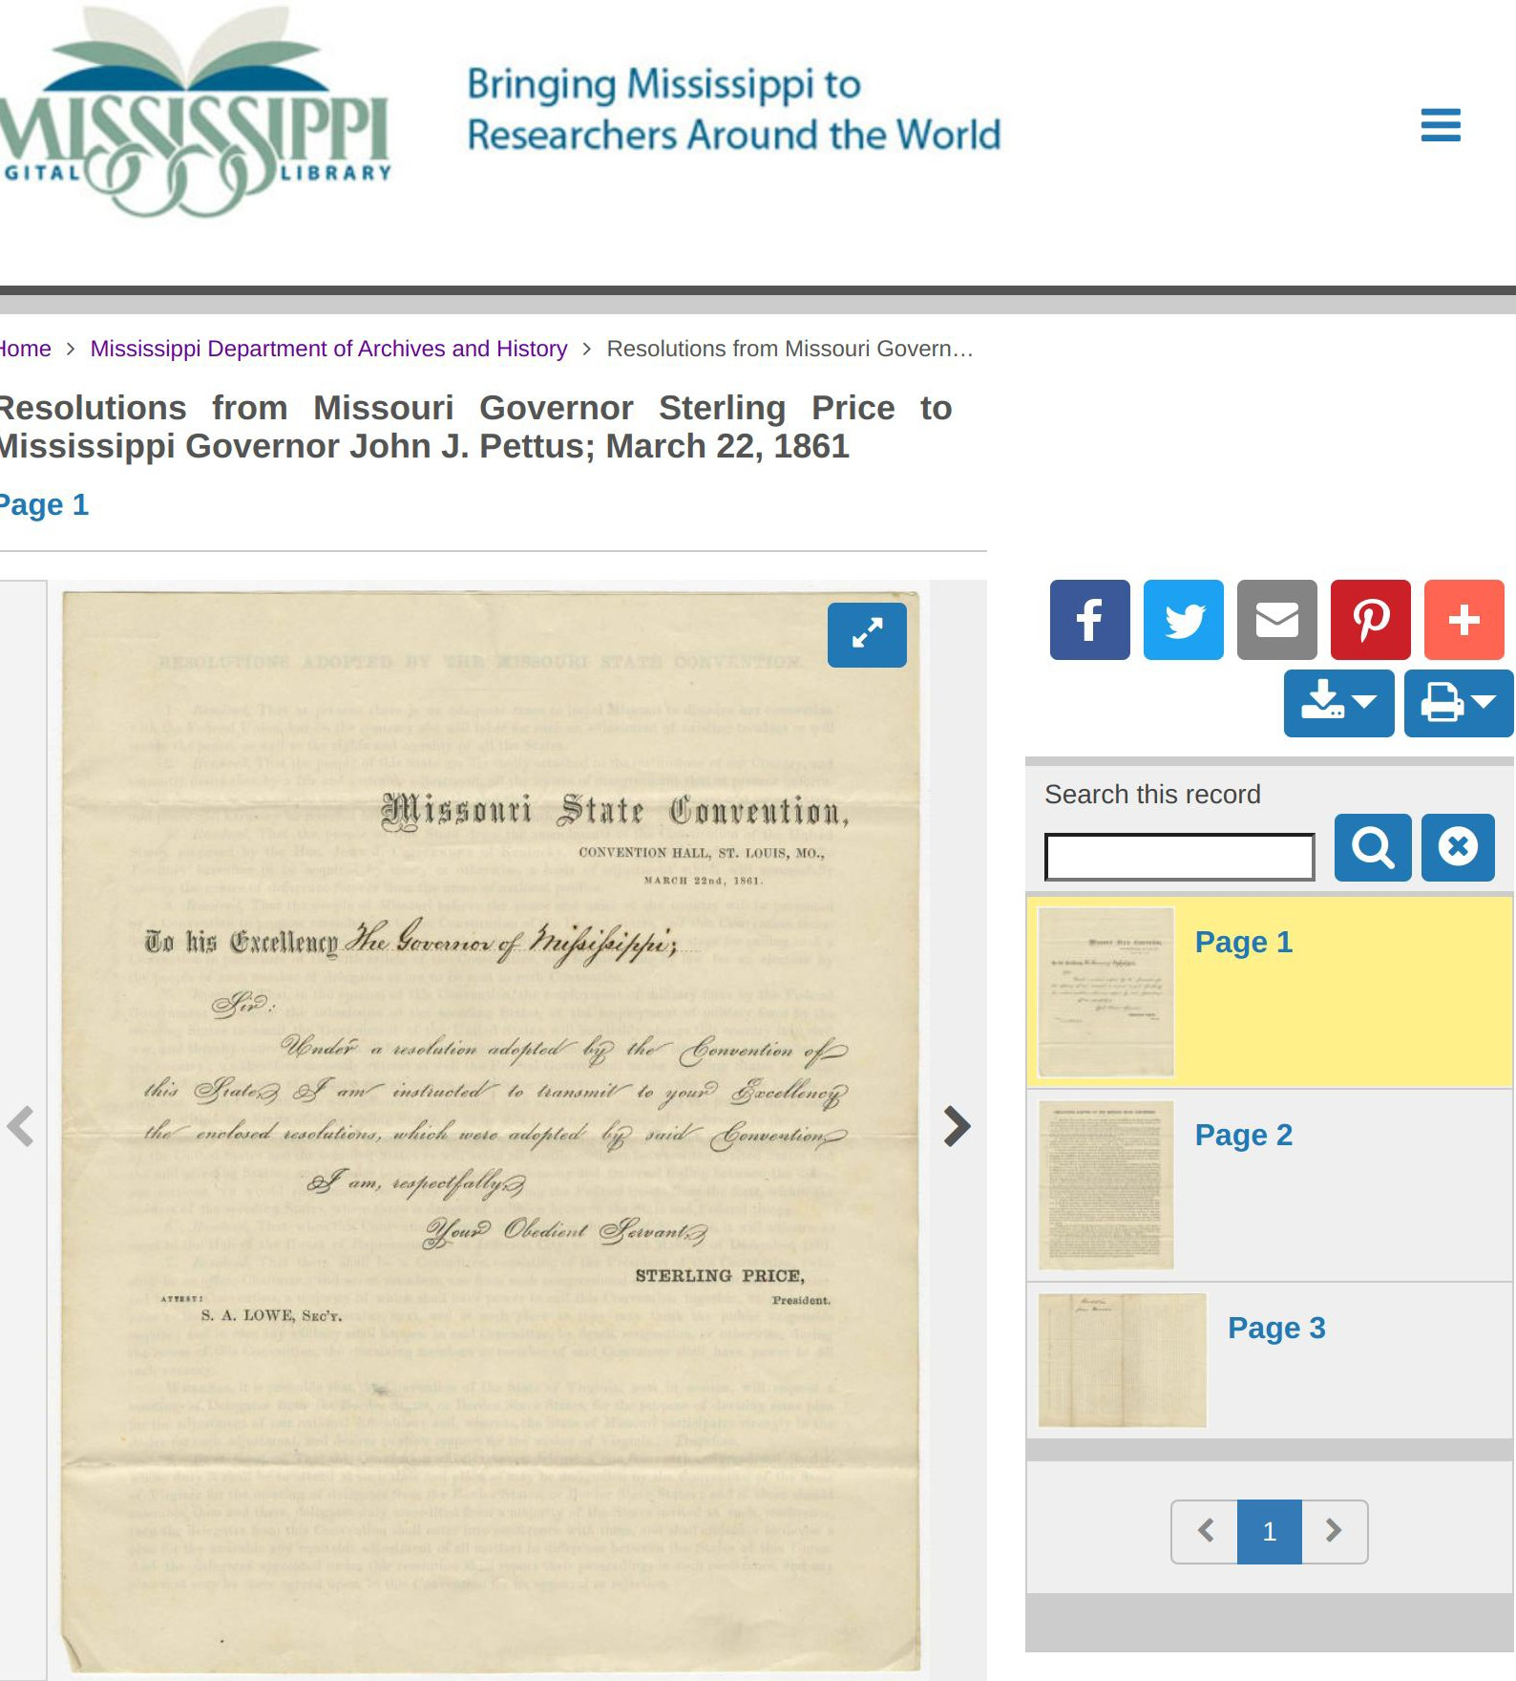
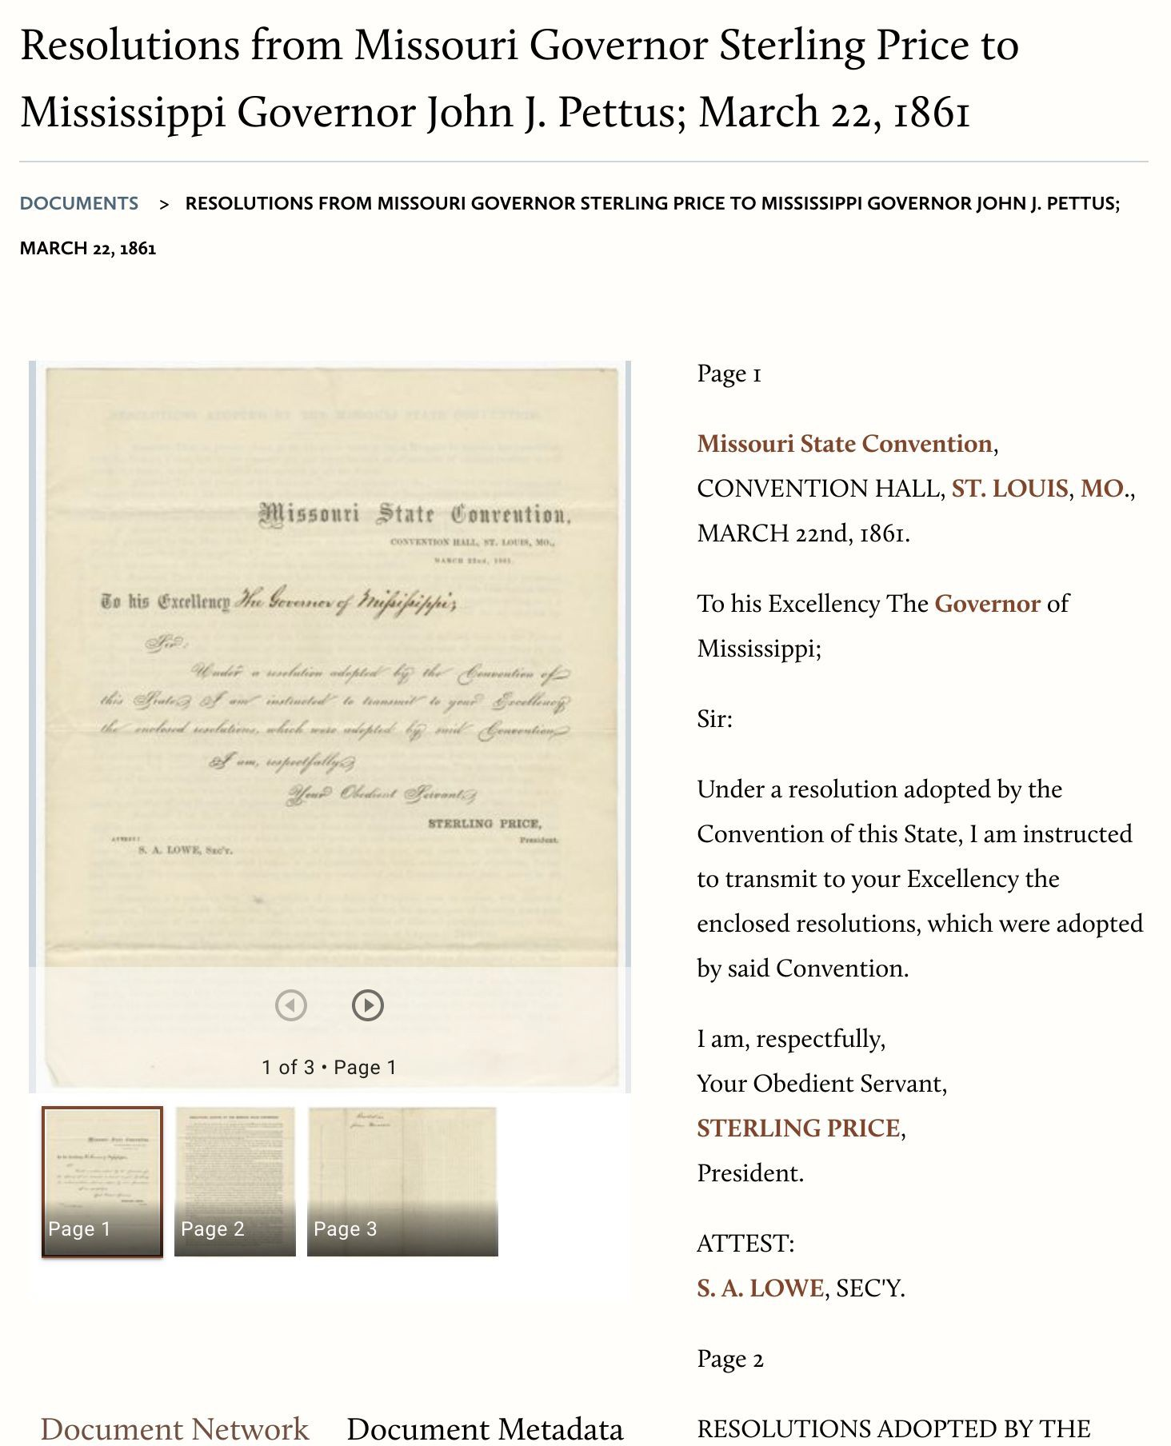
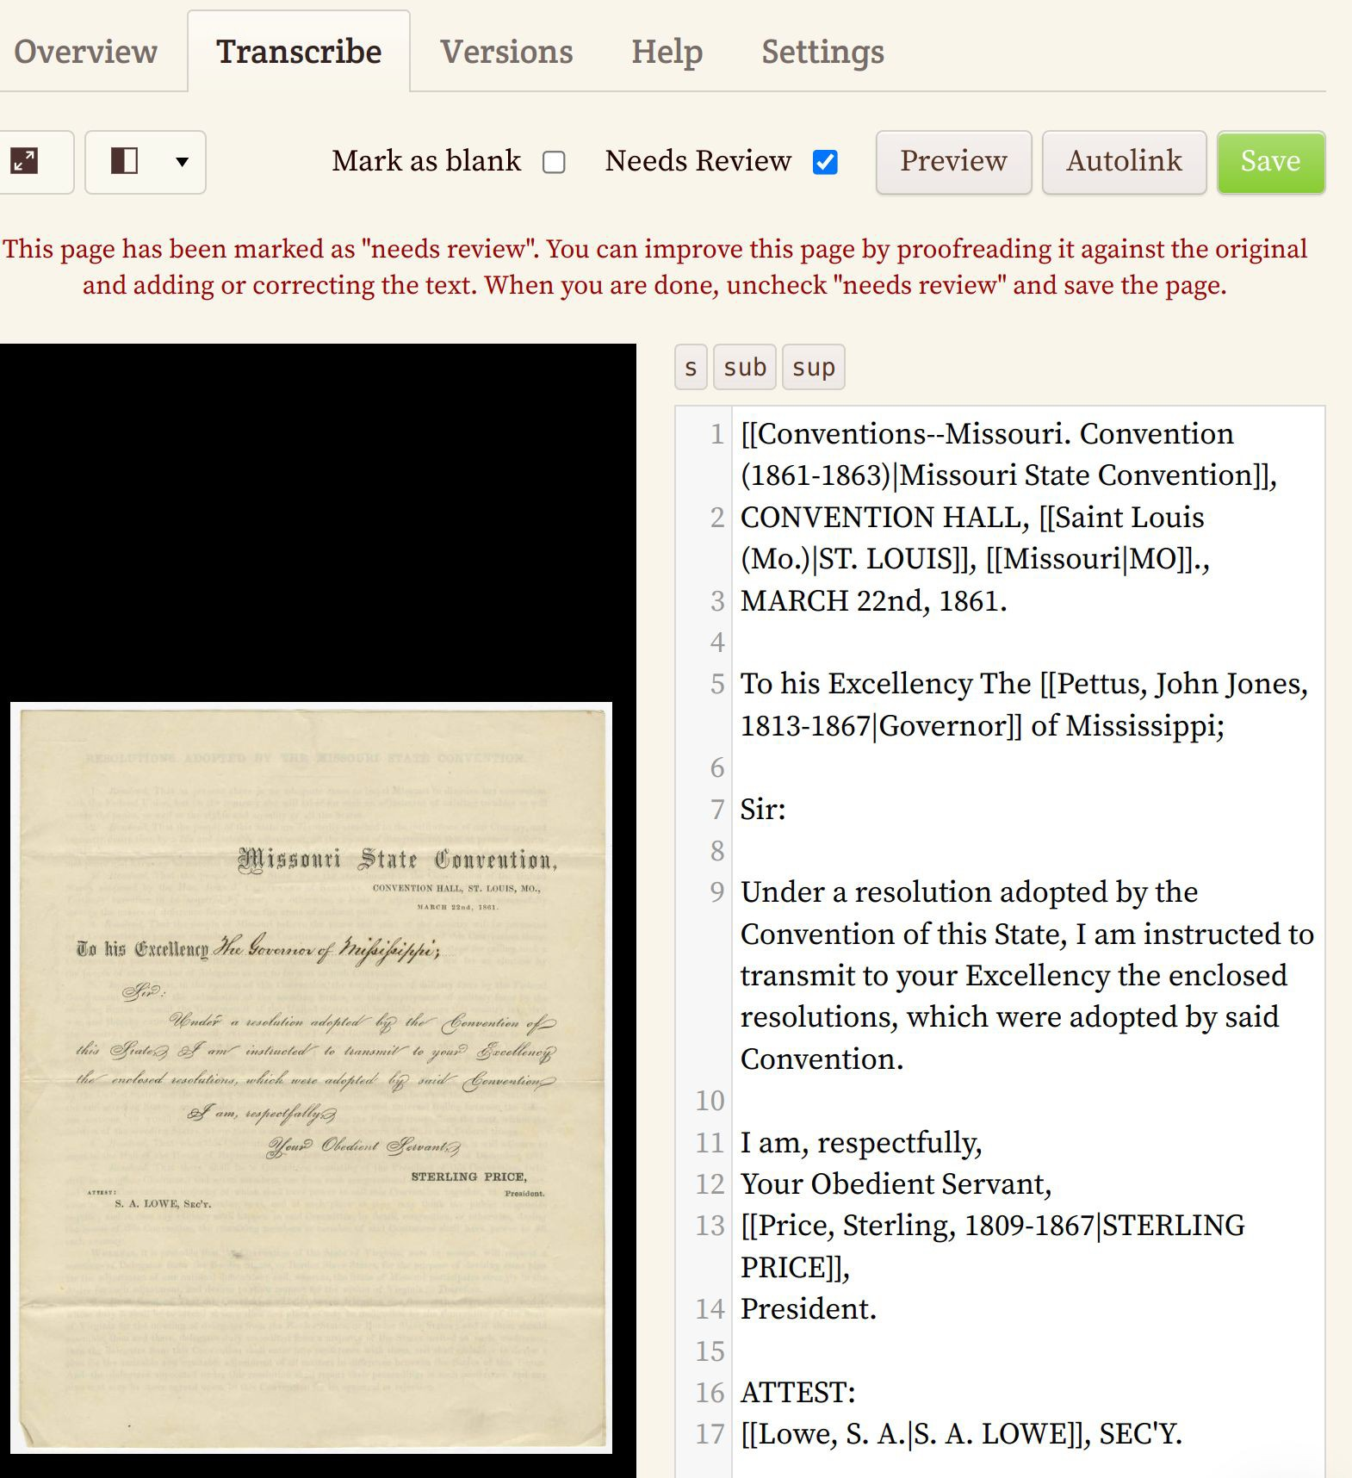
Mississippi Digital Library
FromThePage
CWRGM.org
IIIF-based data flow

Slide 27
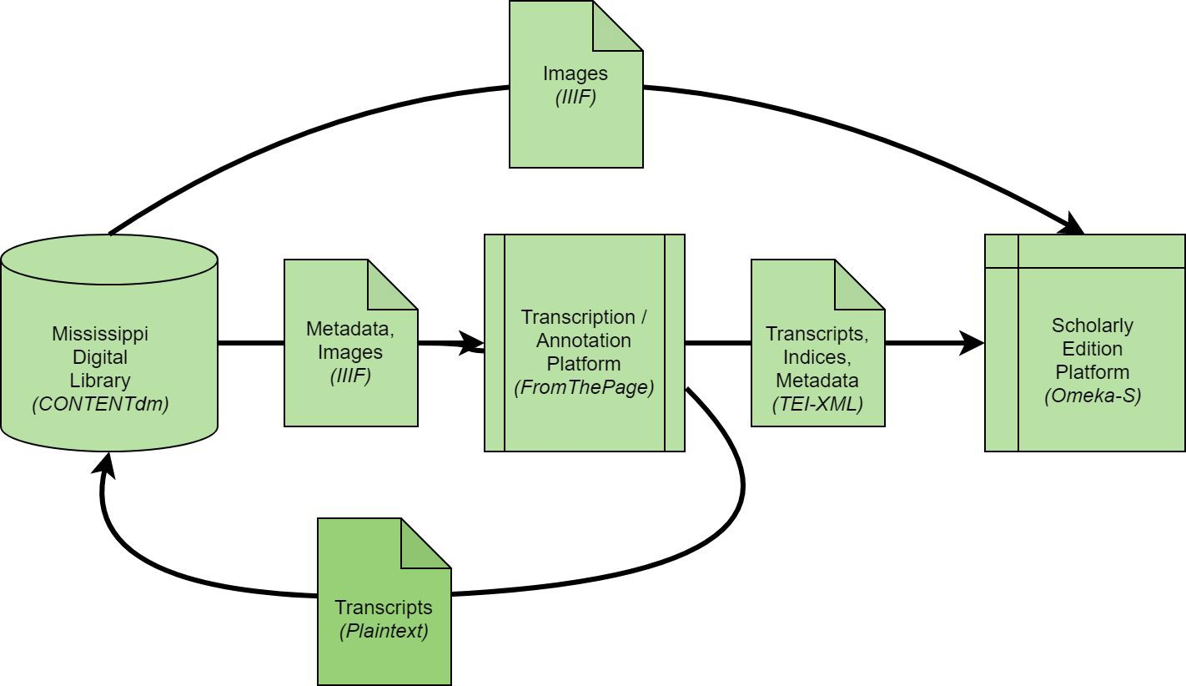
Civil War and Reconstruction Governors of Mississippi
data flow

Slide 28
Work-flows for public crowdsourcing within digital scholarly editions

Slide 29
CWRGM Workflow
Activity
Digitization Transcription Review
Mark-up and Indexing Research and Annotation Review
Publication
Actor
Mississippi Digital library Volunteers
Research Assistants Research Assistants Research Assistants Editors
Editors

Slide 30
Integration workflows with Transkribus, Omeka-S, and FairCopy

Slide 31
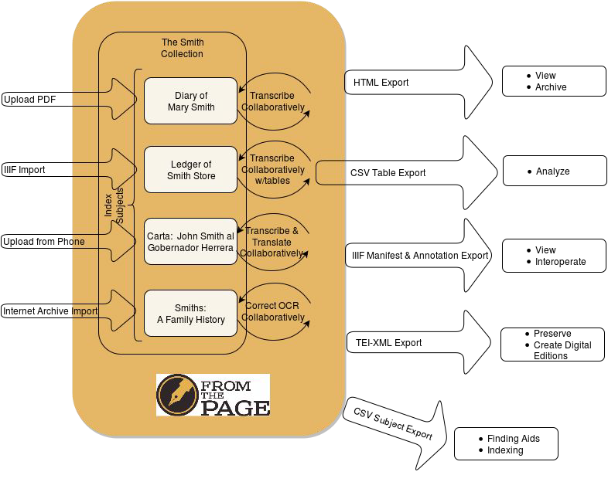

Slide 32
Integration Options
FromThePage -> IIIF Manifest + TEI-XML -> FairCopy
Transkribus (HTR) -> Plain Text -> FromThePage
FromThePage -> Plain Text -> Transkribus (Ground Truth/Training) FromThePage -> TEI-XML -> TEI Publisher
FromThePage -> TEI-XML -> EVT

Slide 33
Beyond transcription:
Structured data indexing for forms, index cards, and ledgers

Slide 34
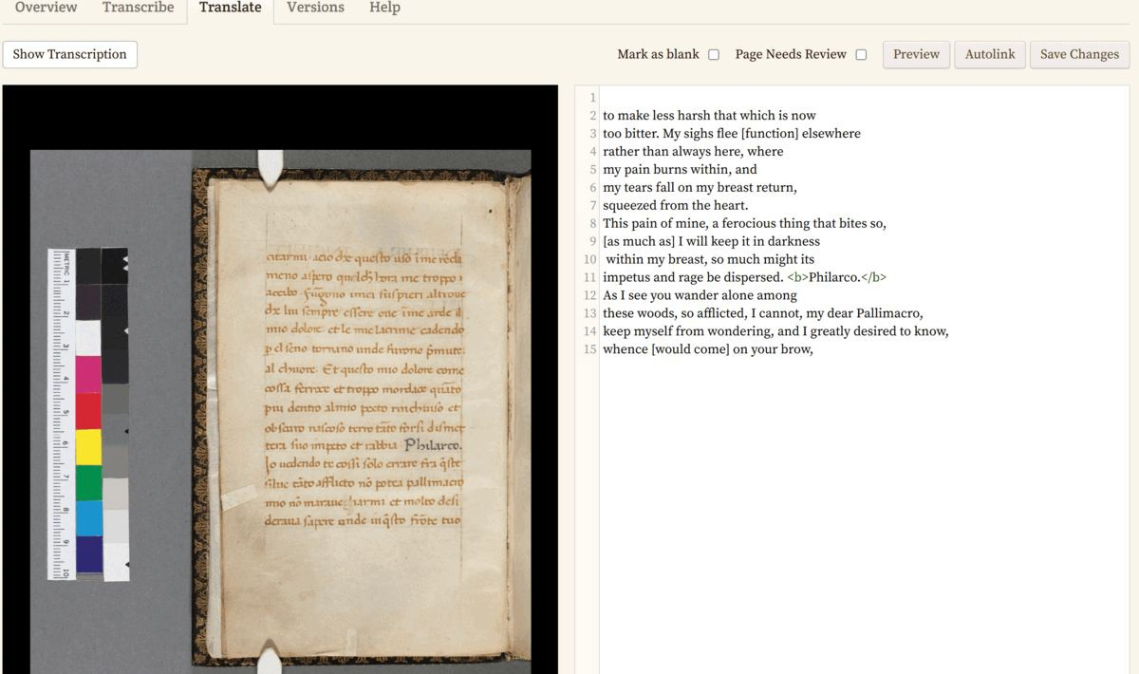
Translate material

Slide 35
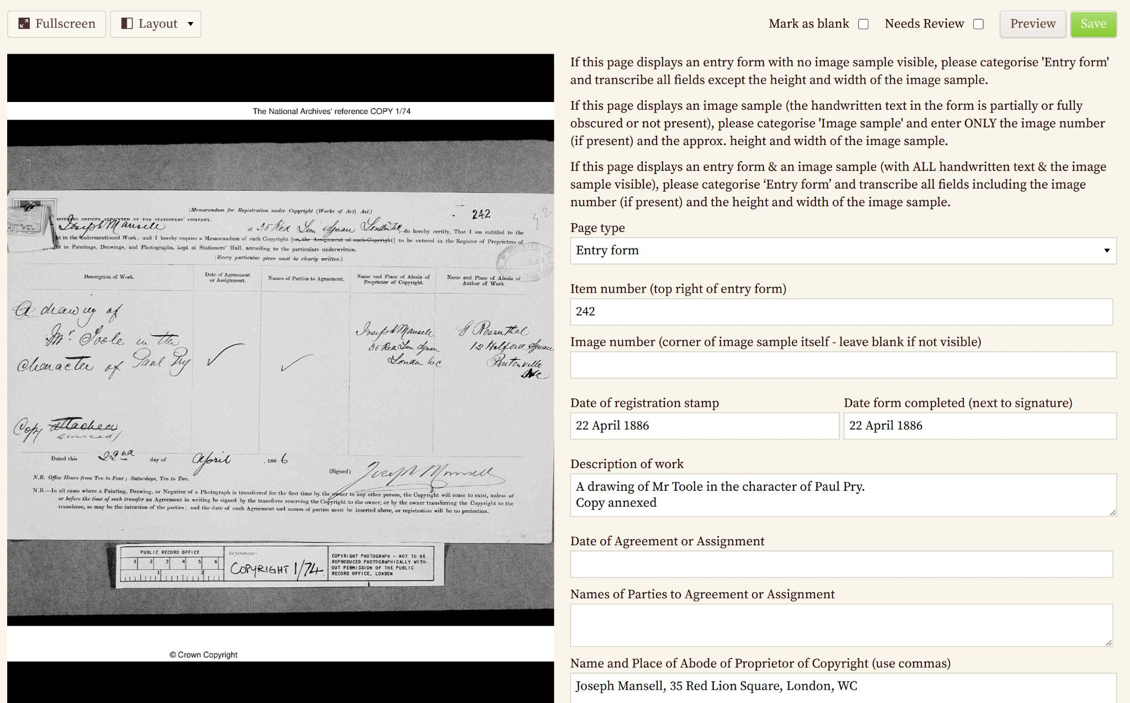

Slide 36
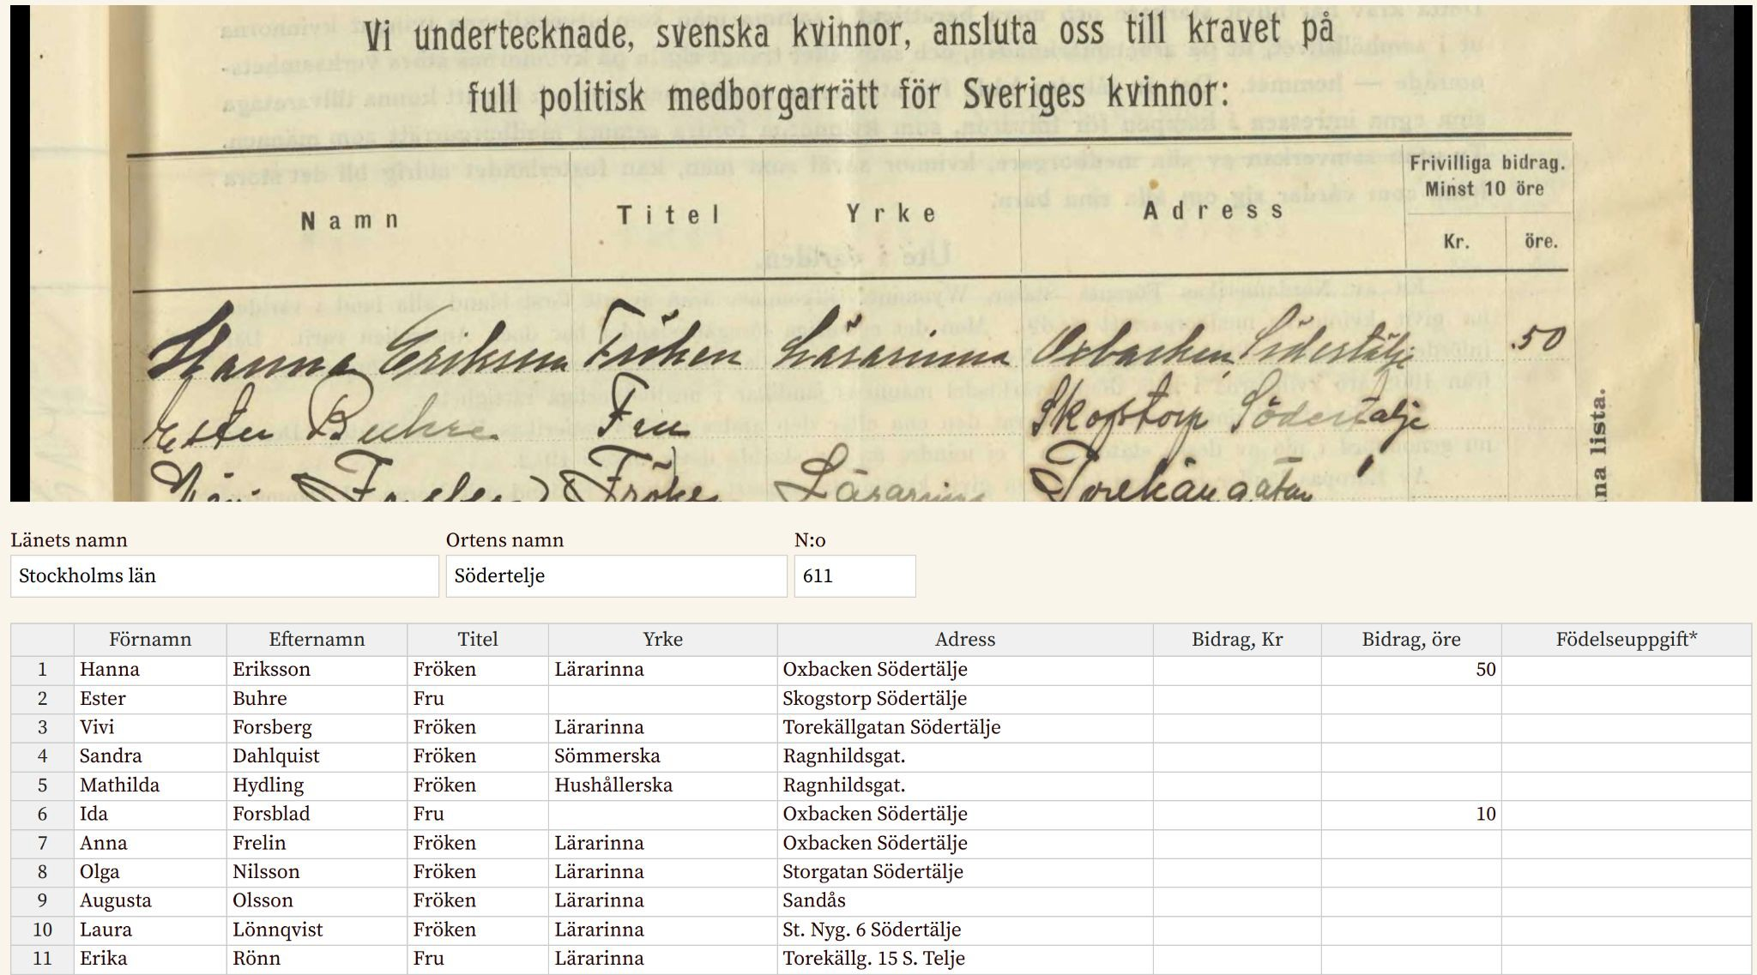

Slide 37
Hands-On Edit-a-thon https://tinyurl.com/DigEdTnT

Slide 38
Sharing our work
IIIF Conference Webinars
Monthly Newsletters
Previous newsletter topics
Trust in the Truth
How Do Holidays Affect Crowdsourcing?
What is Meaningful Work?
Imbalanced Volunteer Engagement
Sign up form: bit.ly/crowdsourcingnewsletter

